Slide 1
Demand Forecasting Using Weighted Moving Average Model
Sumit Nerkar

Slide 2
Problem Statement
The organization faced challenges in predicting monthly order volumes due to fluctuating customer demand and lacked a reliable method to smooth short-term variations for better planning. Traditional forecasting methods like simple moving averages did not account for the varying importance of recent data points.

Slide 3
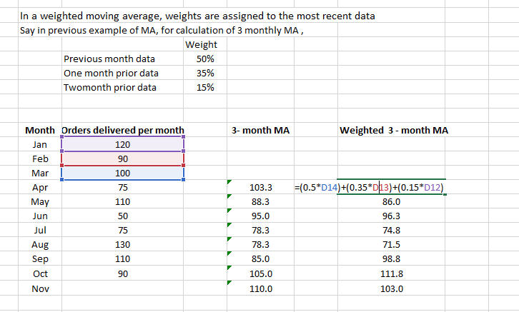

Slide 4
Conclusion
Developed a Weighted Moving Average (WMA) forecasting model in Excel to assign higher weights to recent data points and lower weights to older ones. This approach improved forecast responsiveness and accuracy, helping the team better anticipate demand trends and make informed decisions in inventory and supply planning.

